Slide 1
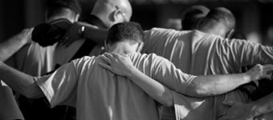
14 Ways to Pray

Slide 2
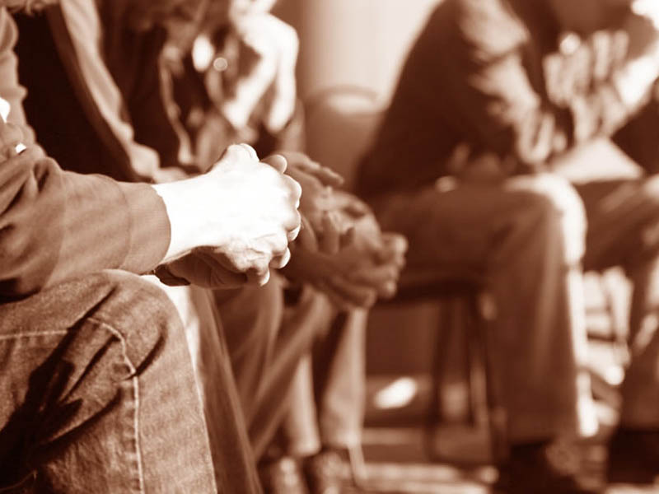
Together

Slide 3
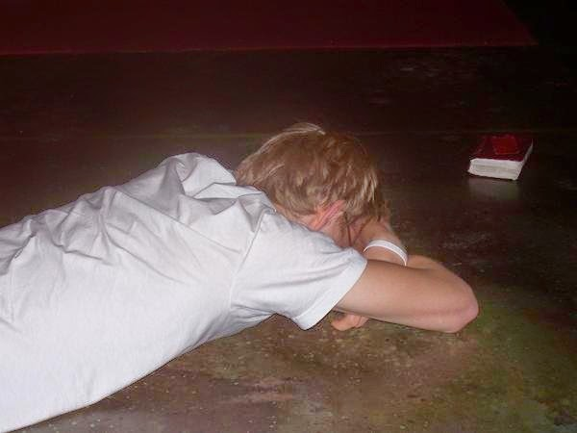
Face-Down

Slide 4
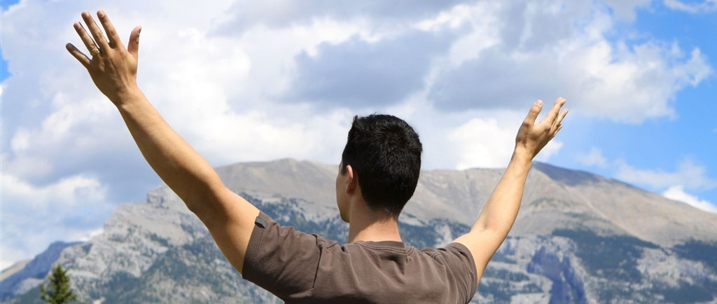
Hands Lifted

Slide 5
Silent

Slide 6
Secret

Slide 7
Walking

Slide 8
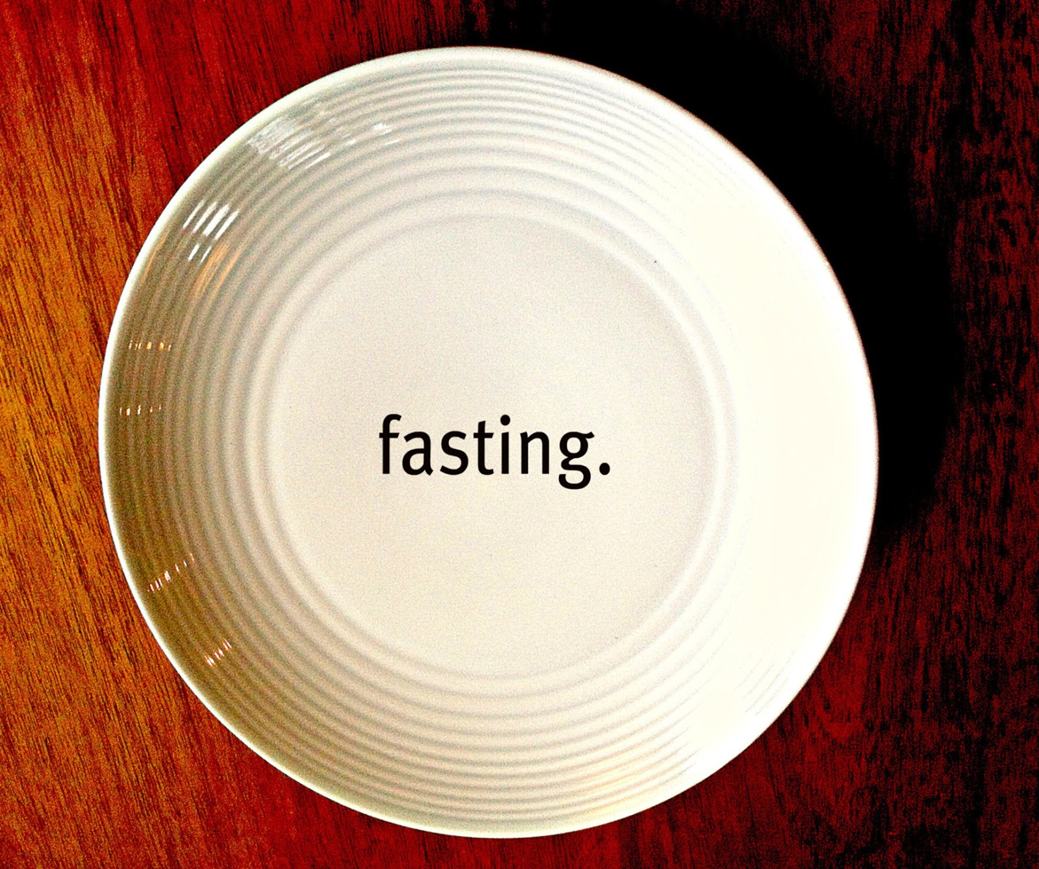

Slide 9
Singing

Slide 10
Waking

Slide 11
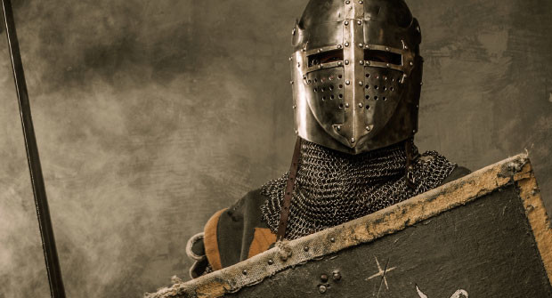
Warring

Slide 12
Enemy

Slide 13
Groaning

Slide 14
Weeping

Slide 15
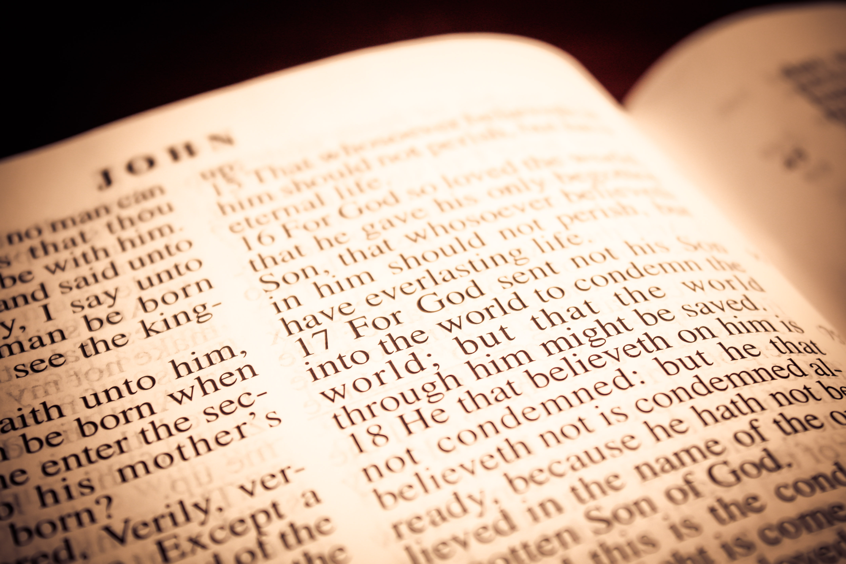
Scripture

