Slide 1
The Three Movements of Prayer

Slide 2
The Three Movements of Prayer

Slide 3

Speaking

Slide 4
Speaking
You do not have because you do not ask.
James 4:2

Slide 5
Speaking
Call to Me and I will answer you and tell you great and unsearchable things you do not know.
Jeremiah 33:3

Slide 6
Speaking
Call to Me and I will answer you and tell you great and unsearchable things you do not know.
Jeremiah 33:3

Slide 7

Curiosity

Slide 8
Curiosity
You will find Him if you
seek him with all your heart and with all your soul”
Deuteronomy 4:29).

Slide 9
Curiosity
And without faith it is impossible to please God, because anyone who comes to him must believe that he exists and that he rewards those who earnestly seek him.
Hebrews 11:6

Slide 10
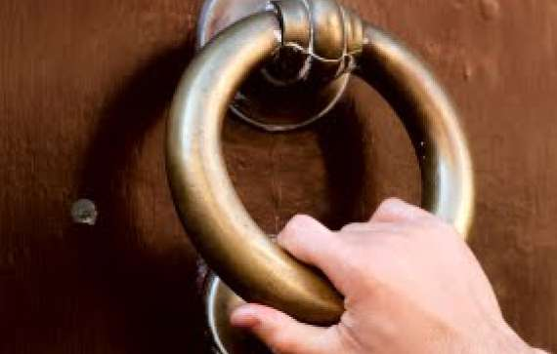
Initiative

Slide 11
Initiative
So if you are offering your gift on the altar, and there you remember that your brother has something against you, leave your gift there in front of the altar. First go and be reconciled with your brother, and then come and offer your gift.
Matthew 5:23-24

